Slide 1
Project on web development Project name: Online School system
Course no: CSE3100
Course title: Web development laboratory

Slide 2

Submitted to
Prottoy saha
Lecturer
Mahmudul hasan
Lecturer
Department of Computer science and engineering
Khulna University of Engineering and Technology
Khulna -9203,Bangladesh

Slide 3
Presented by:
Name: Delowar sikder
ROLL :1607094
Department of Computer science and engineering
Khulna University of Engineering and Technology
Khulna -9203,Bangladesh

Slide 4
Development element
Asp.net
Html
Css
Java script

Slide 5
Project Feature
Registration
Login
Homepage
User Profile
Teacher profile
Feed back
Logout

Slide 6
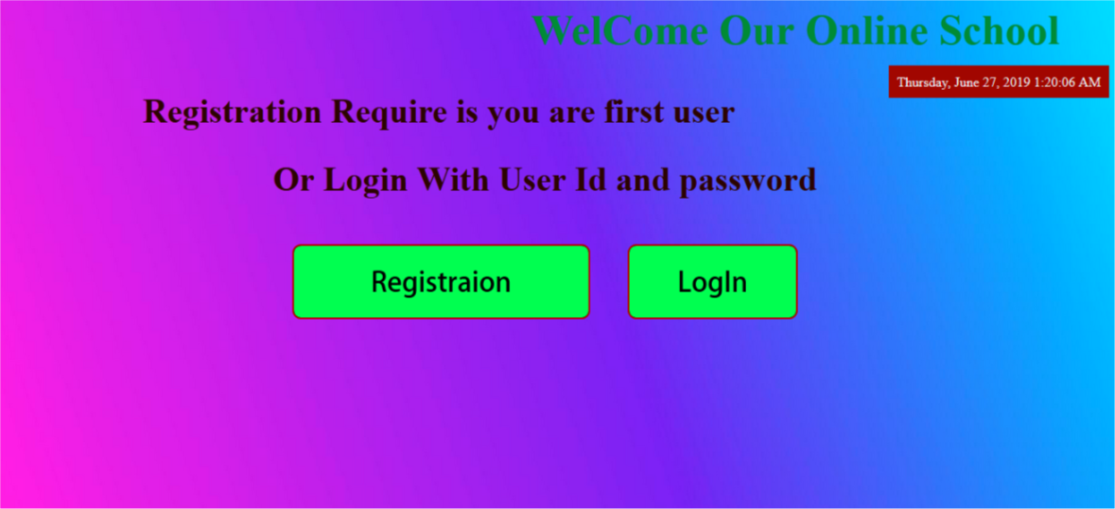
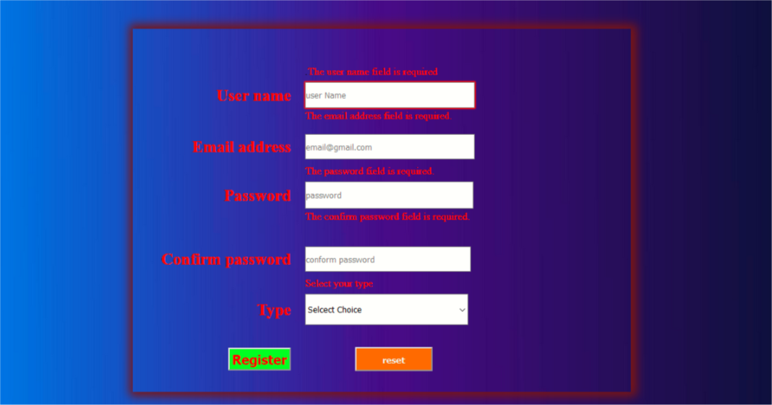
Page over view

Slide 7
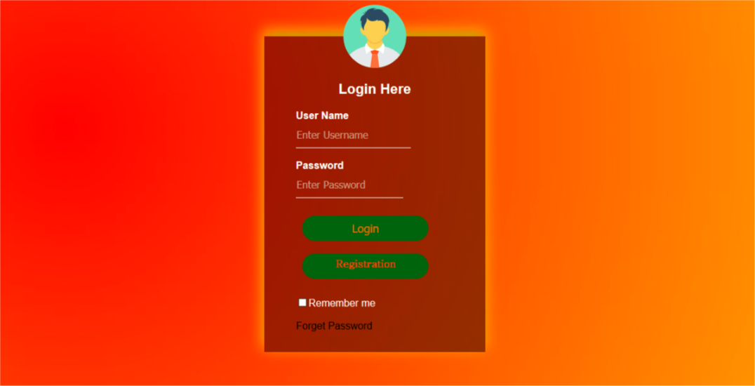
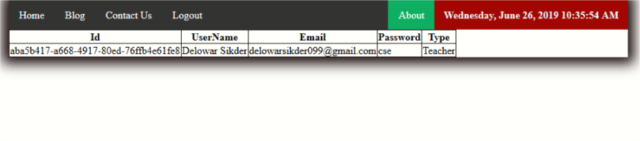
Page over view

Slide 8
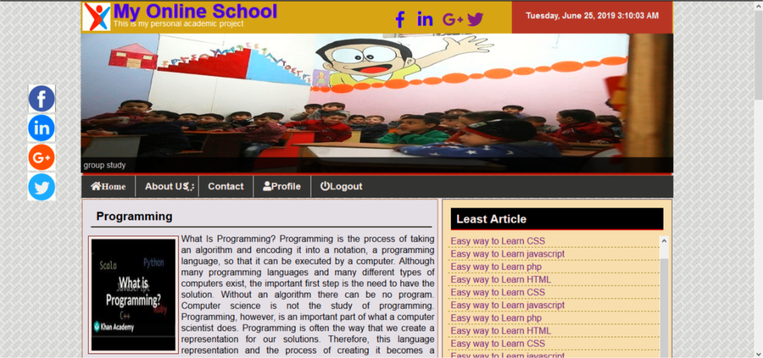
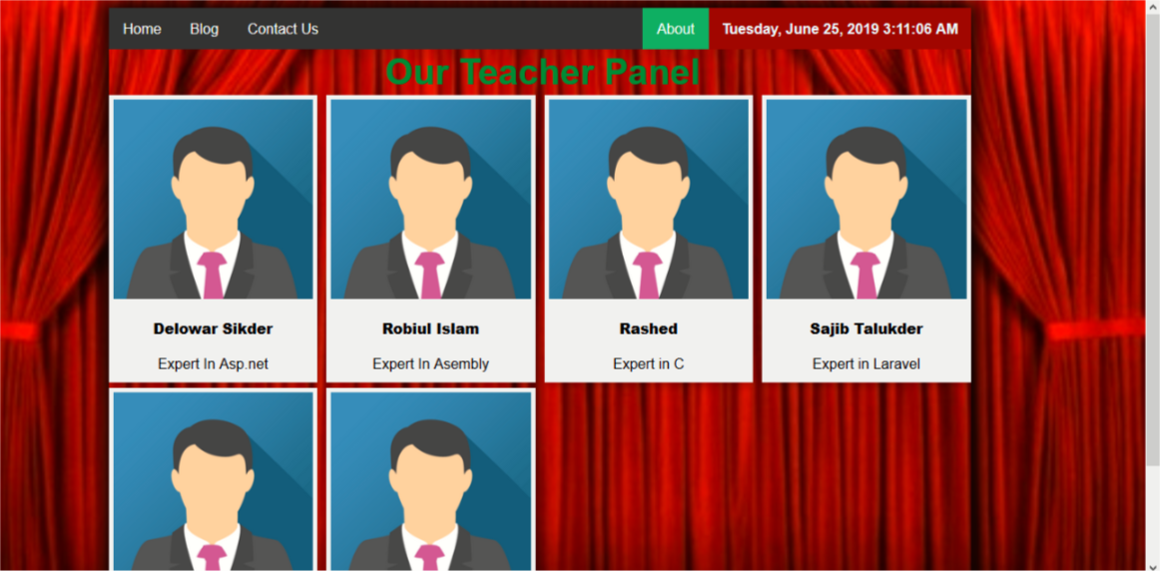
Page over view

Slide 9
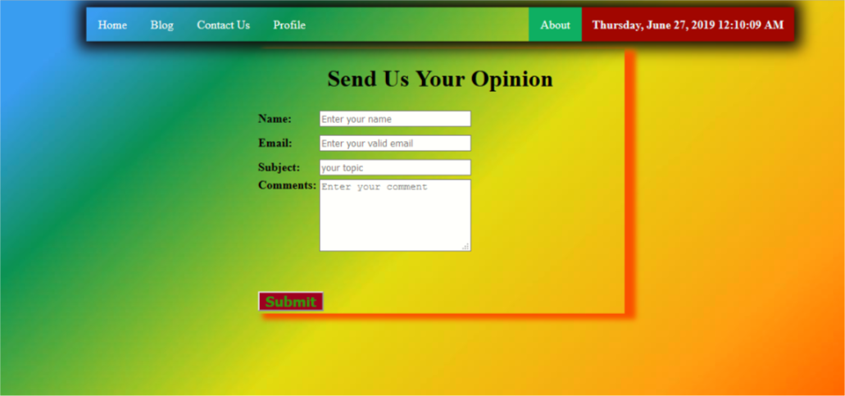
Page over view

Slide 10
Thank you
My project link : https://github.com/delowarsikder/WebDevelopmentProject

